Slide 1

Mozambique’s experience decentralizing HIV-RT proficiency testing panel production
HIV RTCQI Best Practices workshop – African Region
Cape Town| June 3-7, 2024

Slide 2
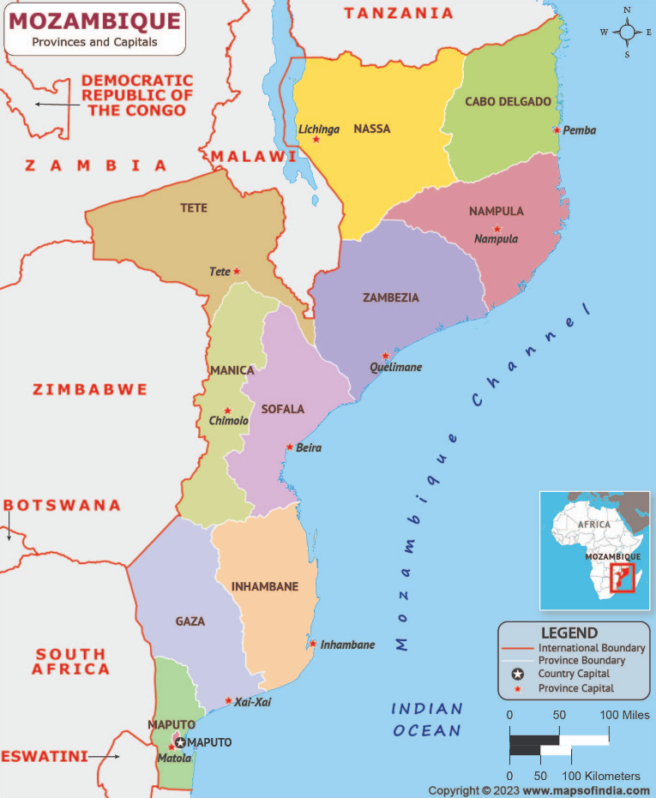




Country contextualization
Geographic location: in the Southern Africa Eastern coast.
Total area: 801,590 Km².
Population: 32,077,072 inhabitants (PopulationPyramid.net: 2021).
HIV prevalence: 12.5% in people aged 15-49 years old (INSIDA, 2021).
HIV annual incidence: 0.43%, corresponding to approx. 63,000 new cases of HIV/year among adults (INSIDA, 2021).
HIV status awareness: 71.6% in adults (INSIDA, 2021).

Slide 3
chronology of the Mozambique PT Program
1986
Malaria and AFB microscopy PT schemes initiated in country by the National Institute of Health (INS).
2004
Re-introduced after a while, with CD4 and HIV serology PT panels coming on board.
2010
Established as an integrated PT program by INS through its National Program for External Quality Assessment (PNAEQ).
2011 onwards
Other HIV related PT schemes were gradually introduced – HIV-1 EID (high throughput), HIV-1 VL & EID POC, Syphilis (2017), HIV/Syphilis Duo (2023)

Slide 4

Decentralization of PNAEQ

Slide 5

Why Decentralizing?
Expand EQA to increase coverage to testing sites.
Guide the standardized implementation of PT panels in all provinces, through the production and distribution of PT samples led by the Quality Assurance Provincial Programs (PPGQ).
Reduce limitations encountered with the centralized EQA approach provided by the INS, such as the increased costs and time as well as the lack of dedicated staff for providing technical assistance.
Increase appropriation by the provinces as they become part of the process by developing their own PT panels.

Slide 6
Structure of a decentralized PNAEQ
PNAEQ
TWGs
Lot-to-lot verification
Blind rechecking
Lab Mentorship
TA and Mentorship
Proficiency Testing
QMS
PPGQ

Slide 7
Decentralization of HIV-RT PT

Slide 8
Decentralizing the hiv-rt PT
Training of Provincial TWG members
  Initial training: 1 week theoretical + 1week of hands-on
  Mentorship and technical assistance during PT production in the province as needed (2-5 days)
Certification of Provincial TWG members
  Based on performance
  Lasting 3 years
Provincial QA Manager
Head of HIV Ref. labs (INS)
Lab Advisor/ Lab officer (IP)
Blood banks techs
HIV Program Provincial Supervisor (clinician)
Provincial Laboratory Supervisor
Training
Composing the Provincial TWG
Developing Provincial TWG ToR
Mapping & disaggregation of PT participants
PNAEQ
Labs
BB
PPGQ
HTC
Clinics
General Coordination
Training of testing providers
Quality Management of PT scheme
Data entry & Data Management
Participants’ Management
TA and mentorship
Lot-to-lot validation
Site certification
IQC
+

Slide 9
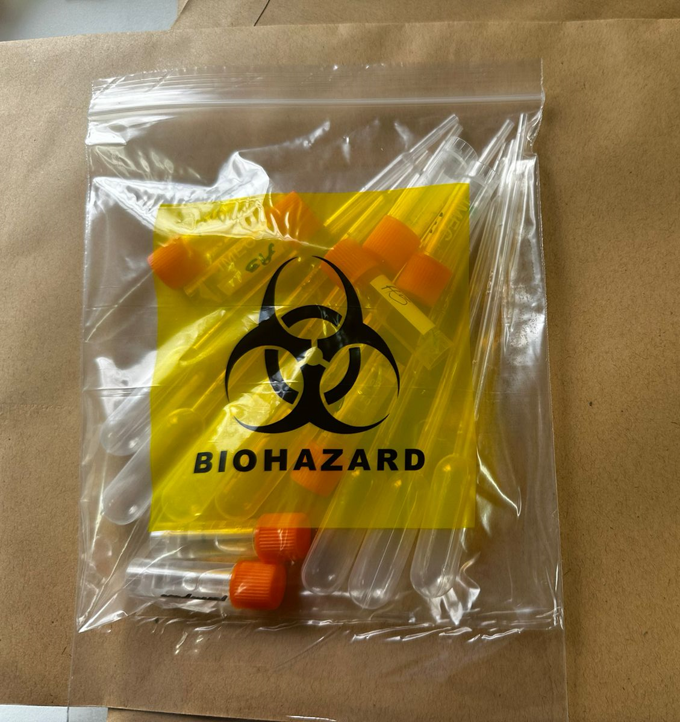
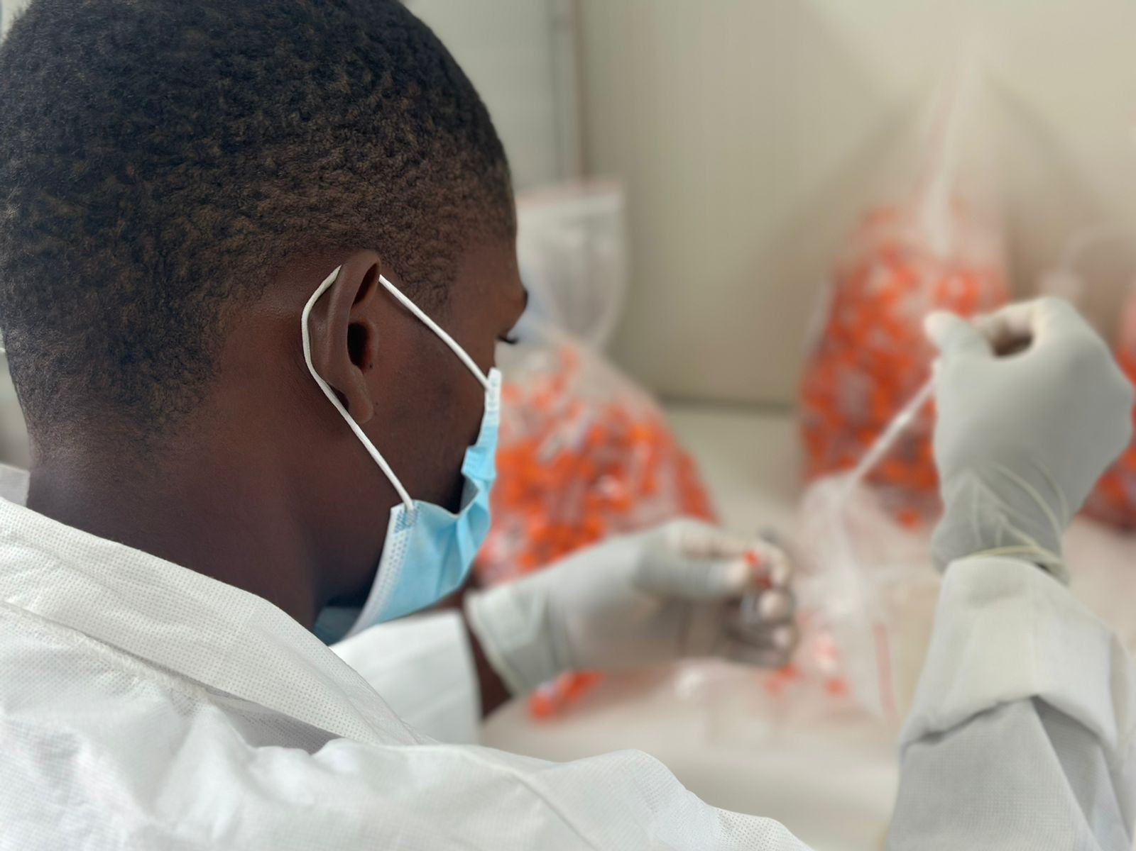
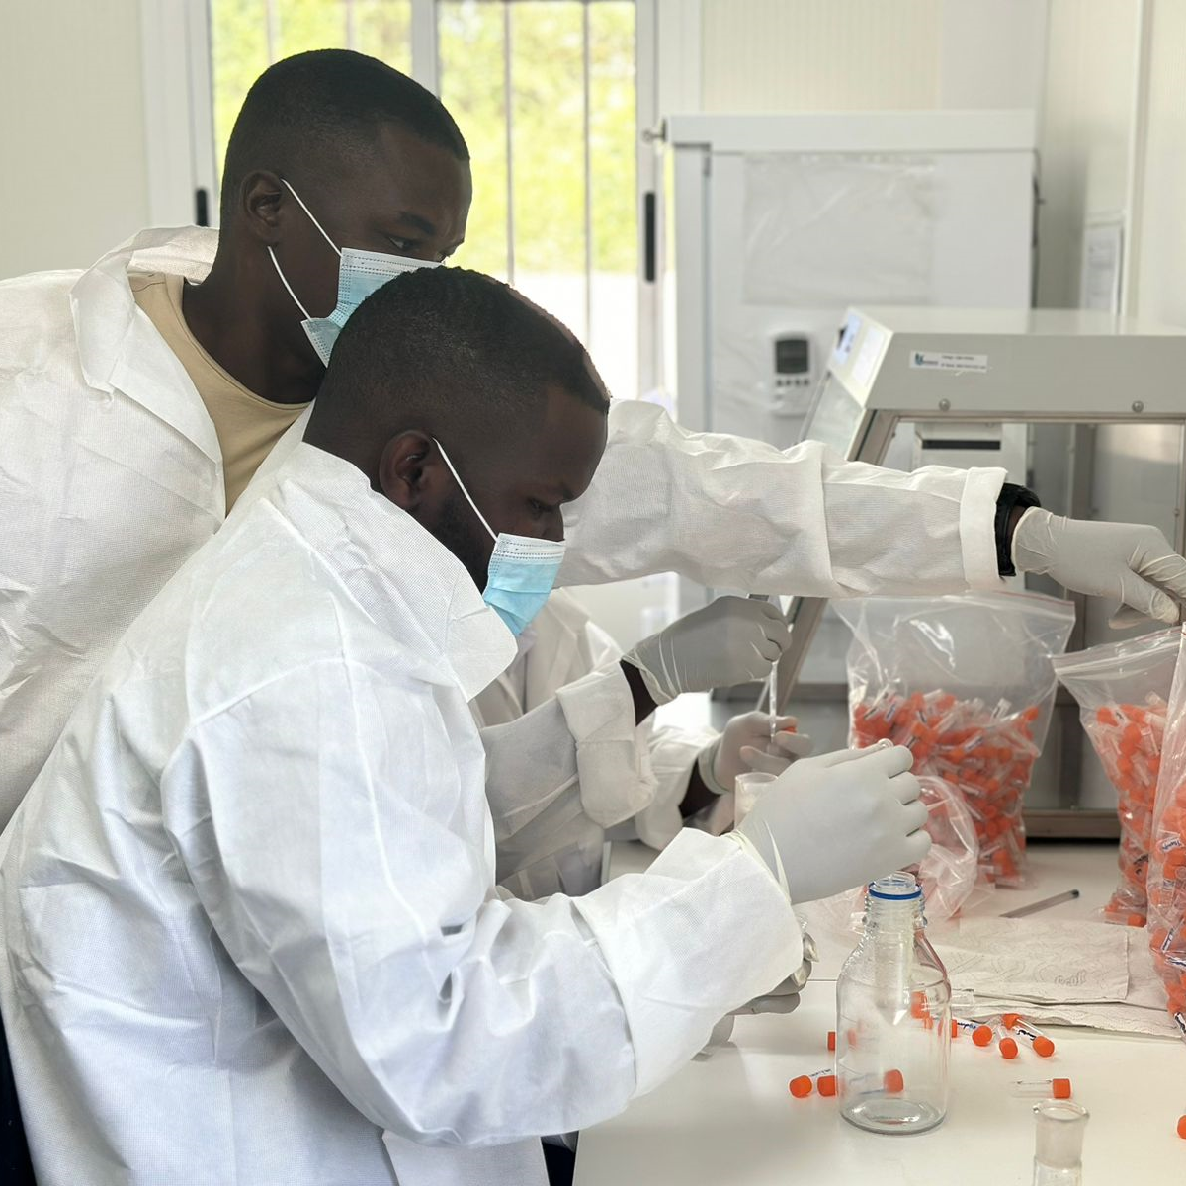
Producing and running decentralized hiv-rt pt panels

Slide 10
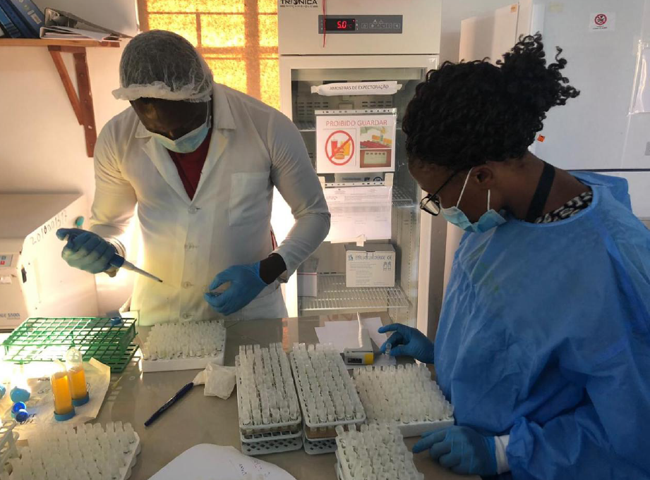
HIV-RT pt cycle
Enrollment of testing sites
Production of PT panel
Validation of PT panel (initial and weekly)
Shipment
Testing window and results submission (one month)
Ending of testing window (last validation)
PT results data analysis
Disclosure of PT report and certificates
Follow up with non-Satisfactory sites

Slide 11
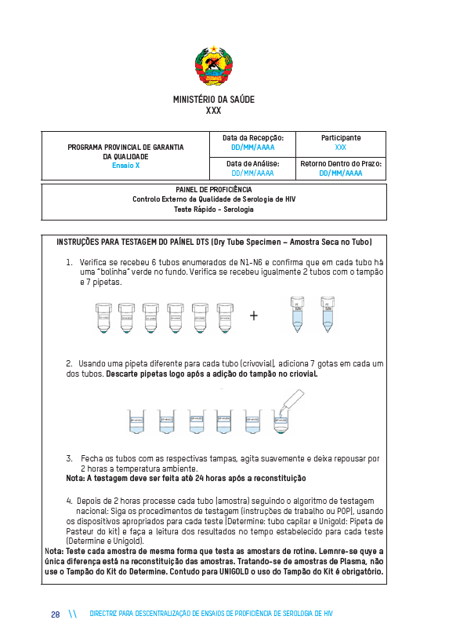
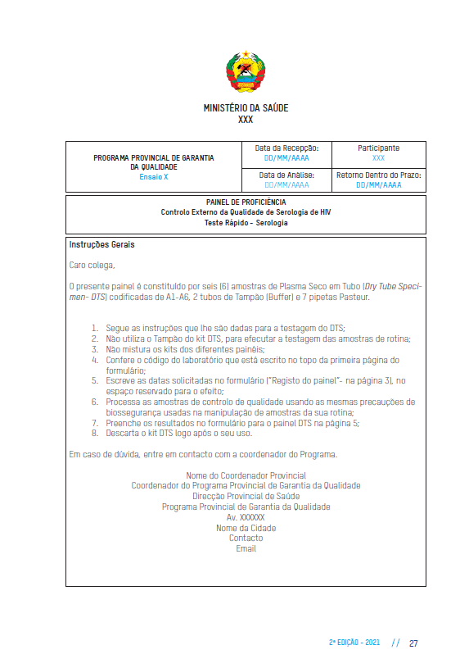
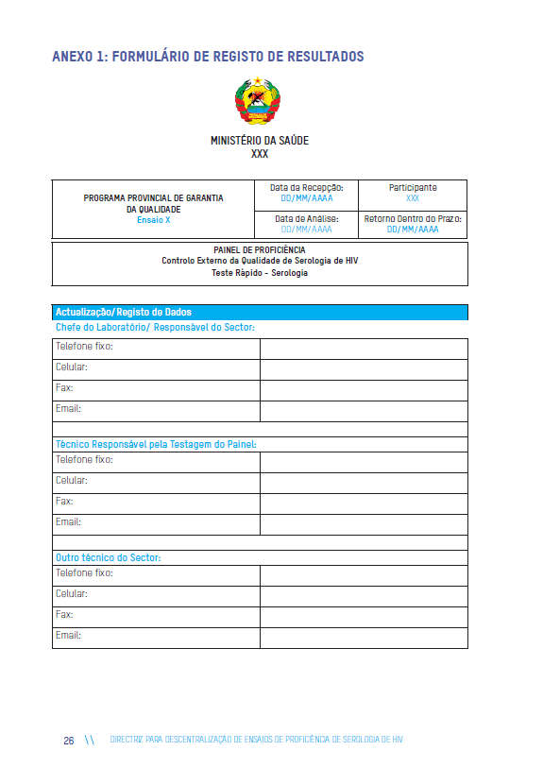
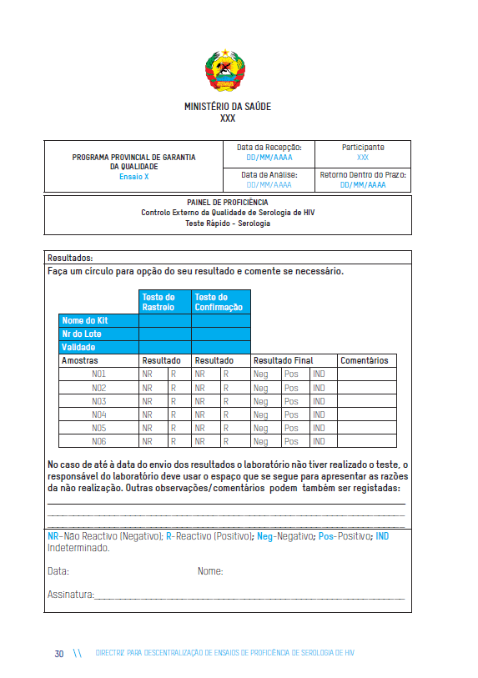
Resources needed
Participant Manual
Participant data collection form
PT general instruction job-aid
PT Shipping and receiving form
PT Results Register form
Previous PT report

Slide 12
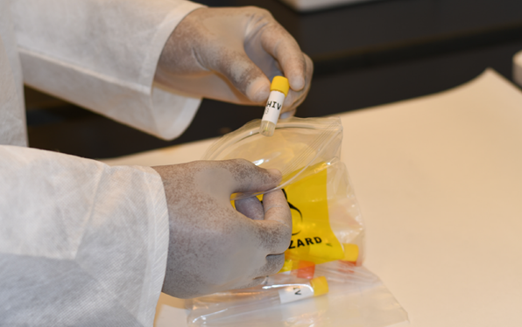
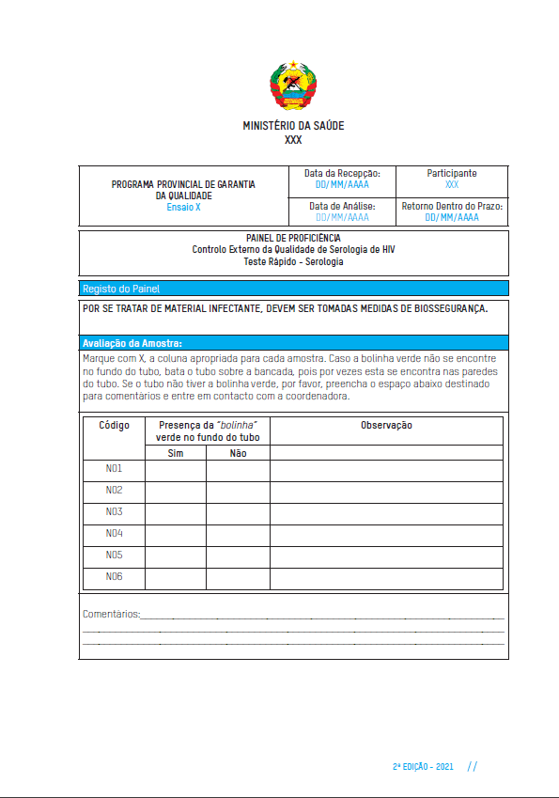
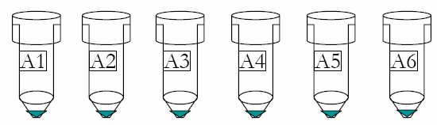
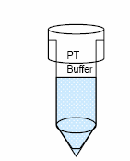
constitution of the pt panel
A zip-lock plastic bag consisting of:
  6 DTS samples,
  2 mL of buffer solution,
  7 disposal pipettes,
  A package insert informing the content as well as instructions on how to perform the assay.
Once received, participants should conduct the inspection of the material and report immediately to PPGQ should it is inconsistent with the package insert.

Slide 13
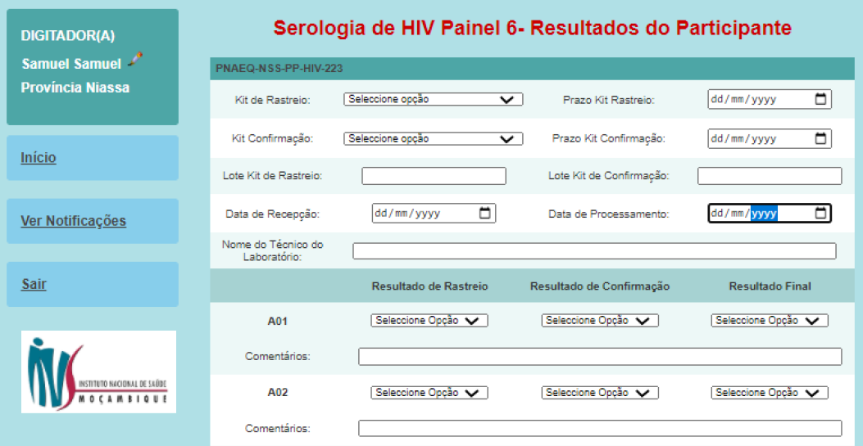
Pt data management
Double entering of PT results.
Participant performance is automatically determined by the software comparing country parameters.
Reports are electronically (email and/or WhatsApp) and/or physically sent to participants (at the next PT shipment).
Those with non-satisfactory results will receive it prior the next PT shipment to ensure corrective actions are promptly taken.
Compliance with the testing algorithm | Reagent shelf life | Participant performance
100% | Expired | Failed
< 80% | Valid shelf life | Failed
>= 80% | Valid shelf life | Satisfactory
100% | Valid shelf life | Excellent

Slide 14

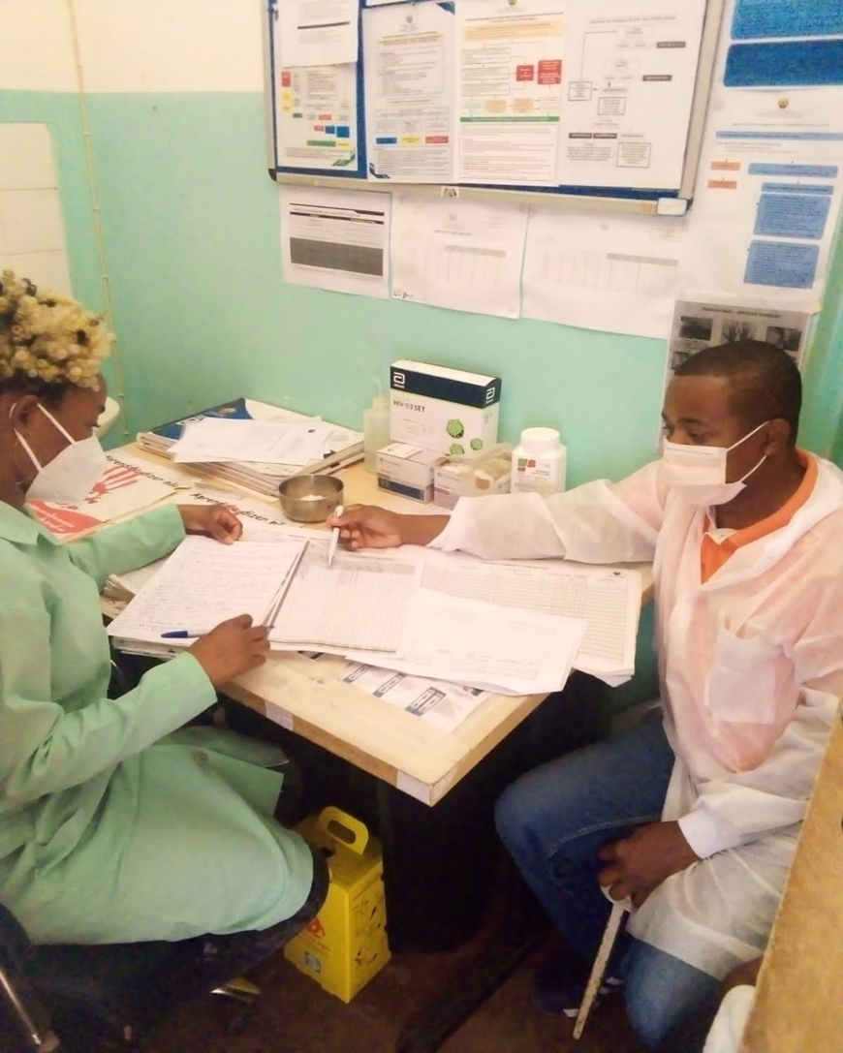
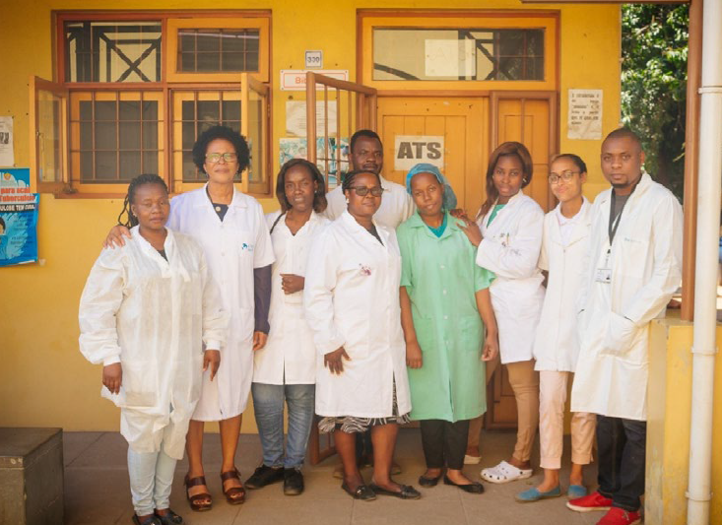
participation acknowledgement and ta
Sites are provided with an annual basis recognition/certification:
  Recognition of Participation, regardless if passed or failed the PTs provided throughout the year;
  Certification of Excellency, should the site has successfully passed all PT panels throughout the year.
Site technical assistance is carried-out at least once a year to all participants with unsatisfactory results, low participation as well as to new testing sites.

Slide 15

Outcomes with the Decentralization of the HIV-RT PT

Slide 16
gains
Increases PT coverage.
Allows technology transfer.
Increases commitment and awareness by both participant and the PT local provider.
Reduces costs associated with logistic.
Allows timely TA intervention.

Slide 17
Challenges
Duplication of PT schemes (PNAEQ + PPGQ).
Lack of resources (staff + financial resources) for running it as per the guideline (2X/year).
Lot-to-lot verification poorly performed.
PT database not fully explored.
Current HIV PT Program not accredited by the ISO 17043.
Lack of technical assistance faced by the sites with low performance.
Late disclosure of PT reports.
Province | Mapped testing sites | PNAEQ provided PTs | % of PNAEQ provided PTs | PPGQ provided PTs | % of PPGQ provided PTs | Total of PTs provided (PNAEQ + PPGQ) | Total PT Coverage (%)
Maputo City | 230 | 18 | 8% | 229 | 100% | 247 | 107%
Maputo Province | 415 | 29 | 7% | 512 | 123% | 541 | 130%
Gaza | 950 | 67 | 7% | 1009 | 106% | 1076 | 113%
Inhambane | 647 | 97 | 15% | 516 | 80% | 613 | 95%
Sofala | 558 | 46 | 8% | 312 | 56% | 358 | 64%
Manica | 638 | 31 | 5% | 468 | 73% | 499 | 78%
Tete | 1083 | 93 | 9% | 386 | 36% | 479 | 44%
Zambezia | 985 | 45 | 5% | 950 | 96% | 995 | 101%
Nampula | 1427 | 61 | 4% | 702 | 49% | 763 | 53%
Niassa | 508 | 69 | 14% | 388 | 76% | 457 | 90%
Cabo Delgado | 655 | 137 | 21% | 280 | 43% | 417 | 64%
Total | 8096 | 693 | 9% | 5752 | 71% | 6445 | 80%

Slide 18

Next steps
Improve the communication among the PT providers (PNAEQ and PPGQ).
Make “lobbies” to get more funds.
Provide guideline and training on lot-to-lot verification.
Advocate for maximizing the PT database utilization.
Enroll the PNAEQ in the ISO 17043 accreditation program and ensure that all PPGQs are certified.
Implement the eLearning (RTCQI-TP) training platform for reaching out more testing providers.
Ensure PT reports are received prior to the next panel and that TA staff are deployed as applicable.

Slide 19
acknowledgement
The National Program for External Quality Assessment - INS
HIV-RT testing sites
Provincial Health Directorates
Provincial TWGs/PPGQ
The National HIV-AIDS/STI Program
The National Directorate of Medical Assistance
PEPFAR implementing partners
Donors (PEPFAR/CDC Mozambique and the Global Fund)

Slide 20
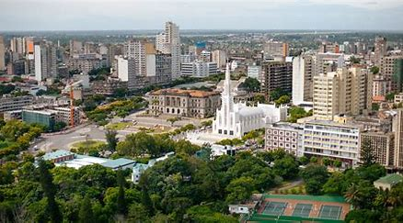


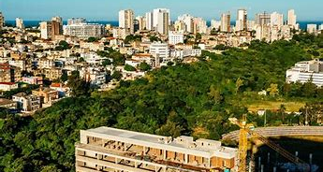



Muito obrigado
The Mozambique Team

